Slide 1

The Little Mermaid
By Jacqueline Goldfinger
Directed by Matt stabile
Costume design by Tim bowman

Slide 2
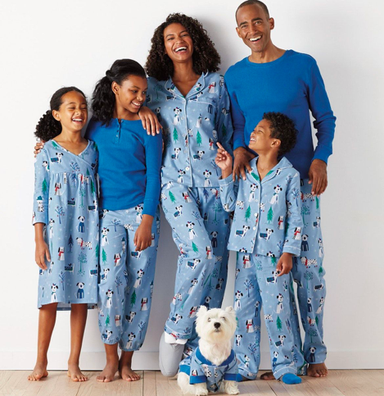
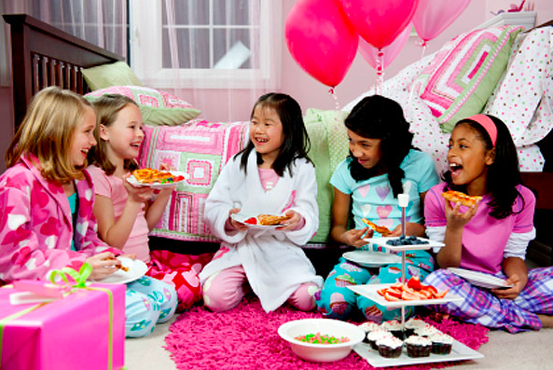

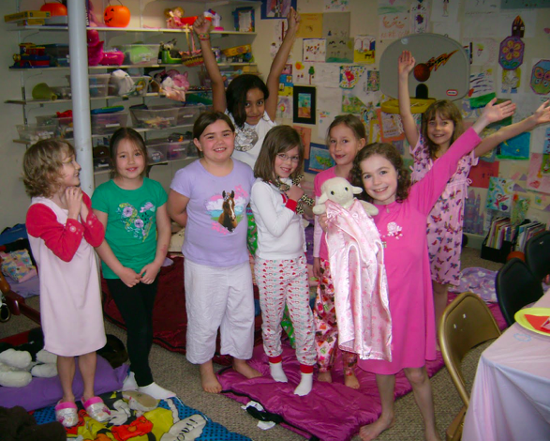
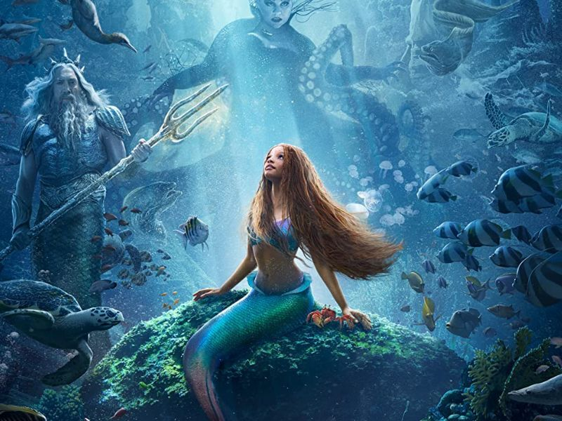
GENERAL RESEARCH

Slide 3
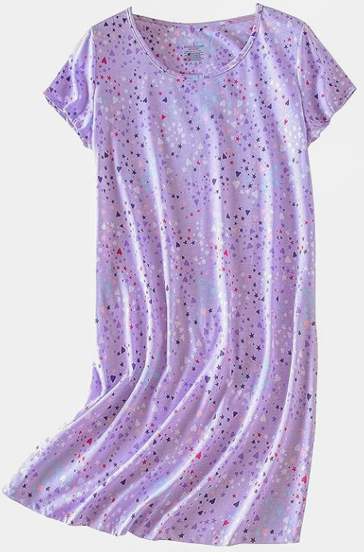

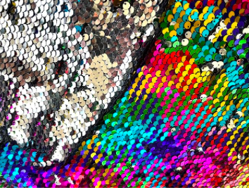
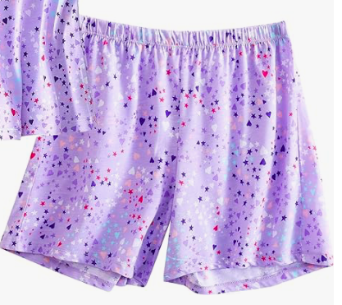
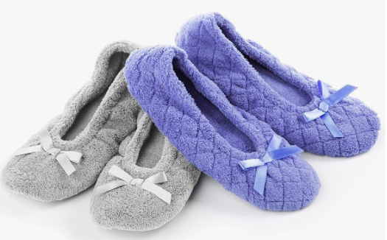
Little Sister
Blanket added for mermaid
Base Pajamas
Night Dress with shorts for modesty.
Sequin blanket to tie around waist for
the mermaid

Slide 4
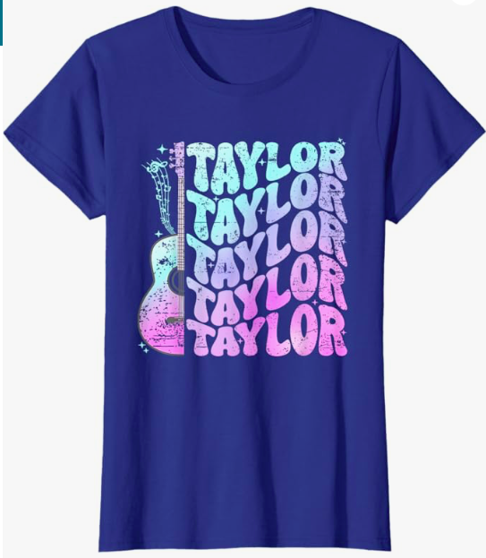
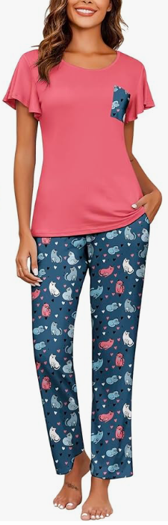
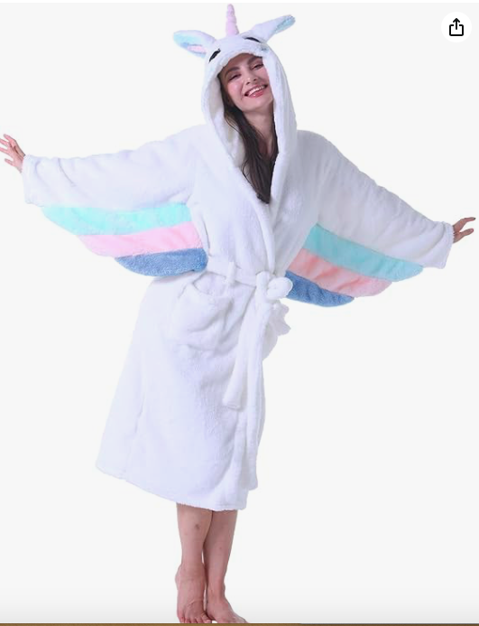
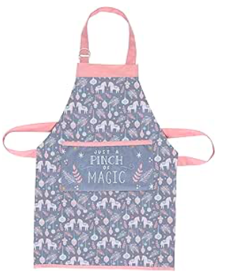
Big Sister
PJ Pants and Pop-icon T-shirt. Slippers to
Protect feet on stage.
ADD Hooded robe when she is the
Seahorse distraction.
ADD Apron for the lady in waiting.
Used in the “Craft area” of the bedroom.

Slide 5
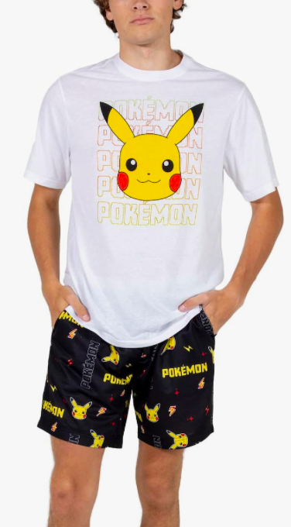
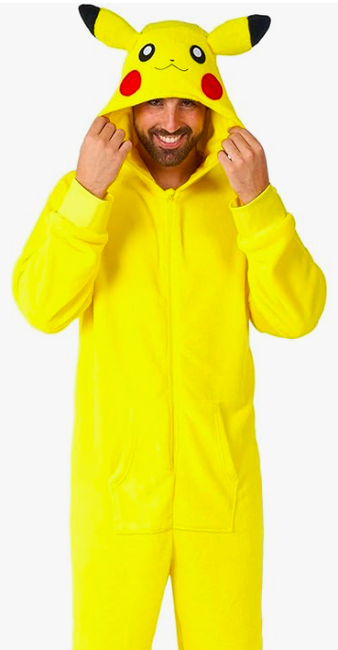
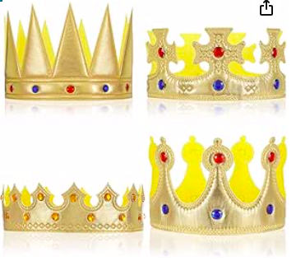
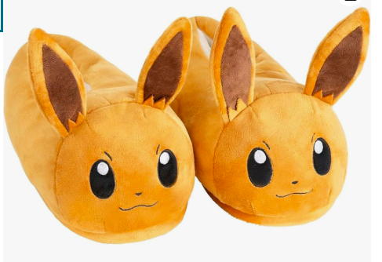
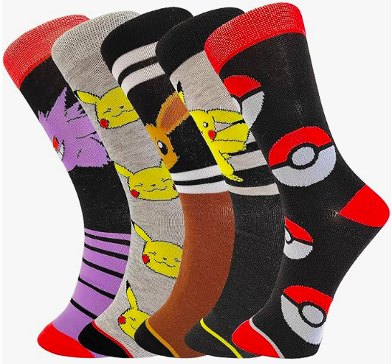
Charlie
Pokémon Onesie with T-shirt and
Shorts underneath. Onesie tucked
Into Pokémon socks, but not
Symmetrically. Giant Eevee
Slippers.
ADD Crown when prince

Slide 6
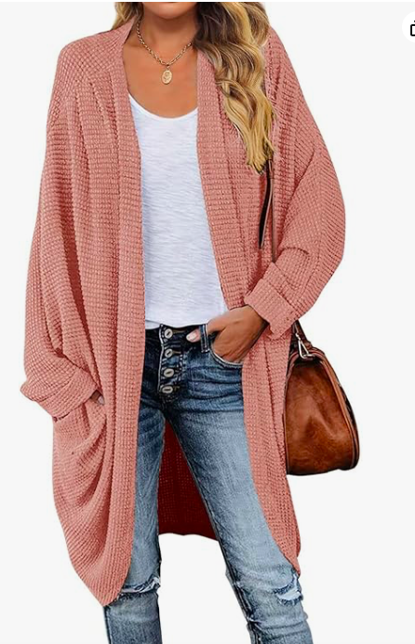
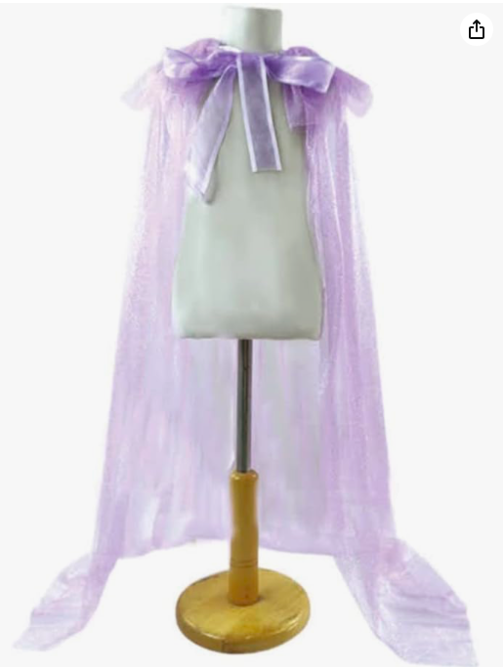
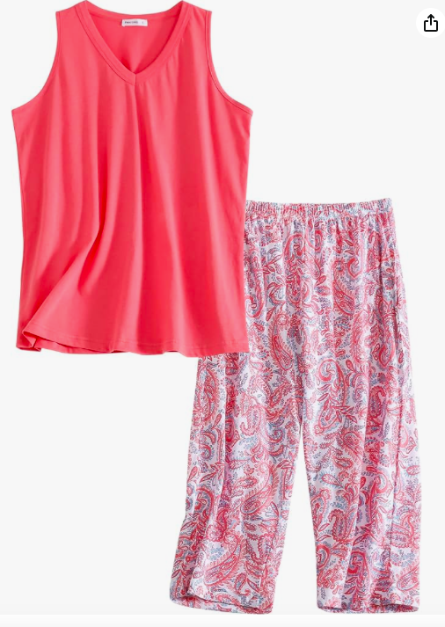
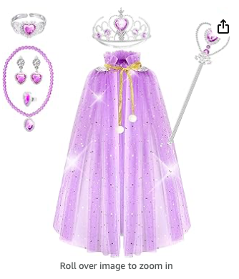
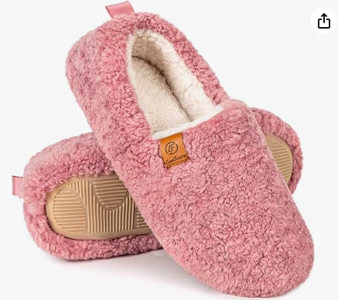
MOM
PJ Capris and t-shirt tank
Top. Cardigan and sippers
To complete the look
ADD tulle cape for the Sorceress.
Cape can swish around dramatically
During the dance. Optional
Addition of the accoutrement
From the girls playset to complete
The sorceress look. It is purple
because Ursula is my favourite.

Slide 7
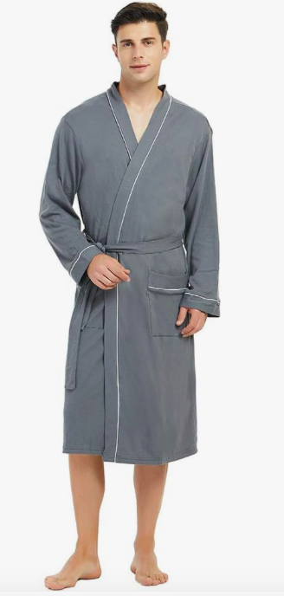
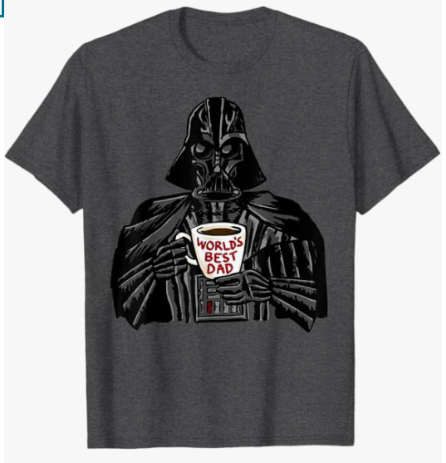
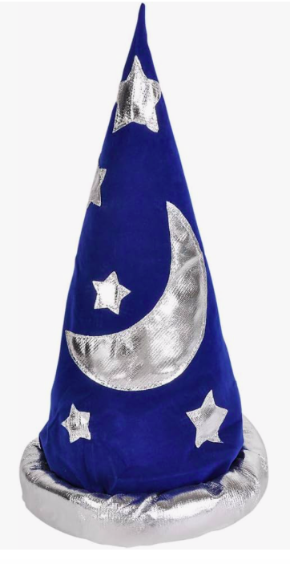
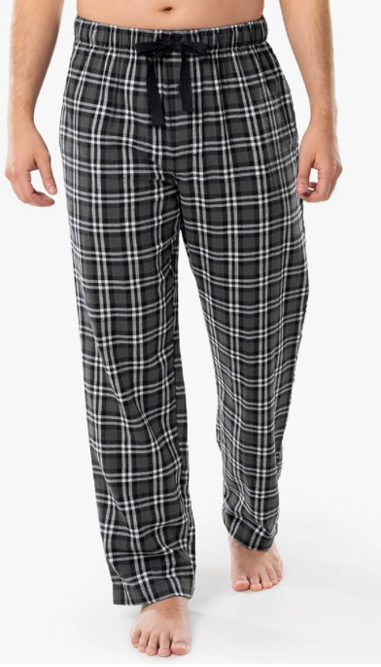
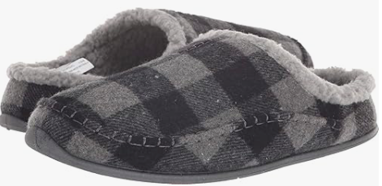
DAD
‘World’s Best Dad’ Tshirt and
Gray plaid PJ pants with gray slippers.
Oversized Gray bathrobe
So if needed, the double headed seahorse
Could be done by both parent sharing it,
One having an arm in each arm.
ADD wizard cap for Apprentice

Slide 8
