Slide 1

Freaky Friday
Design Research
Directed by Ted DeChatelet
Designed by Tim Bowman

Slide 2
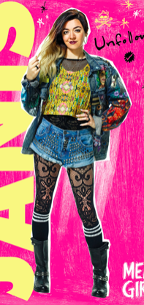
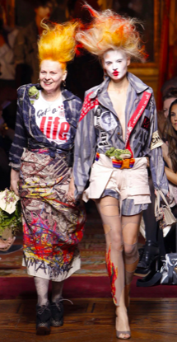
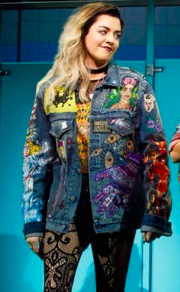
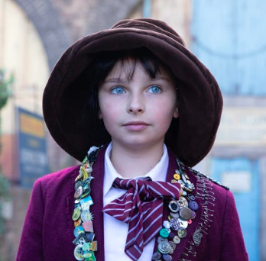
Ellie Blake
Angsty teen, a little counter
culture, against the “perfection”
That is her mom

Slide 3
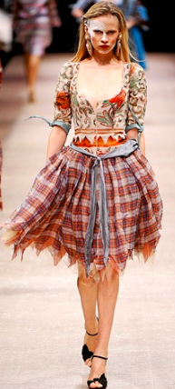
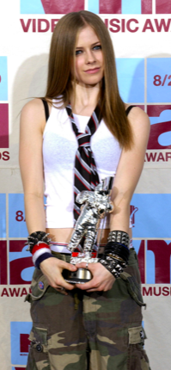
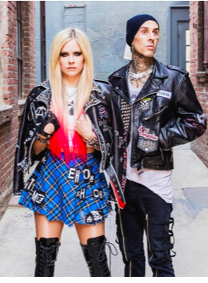
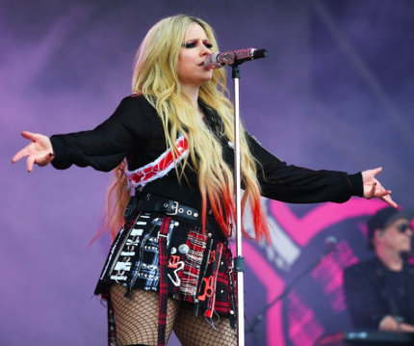
Inspo: Vivian Westwood, Janice in Mean Girls, Emma Stone in Cruella, Avril Lavigne

Slide 4
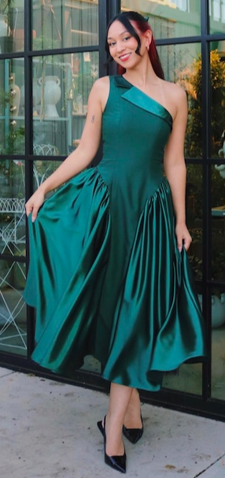
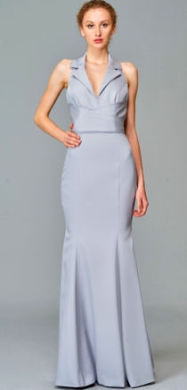
Bridesmaid dress
*slightly* gender non-conforming…
but the most feminine we have seen

Slide 5
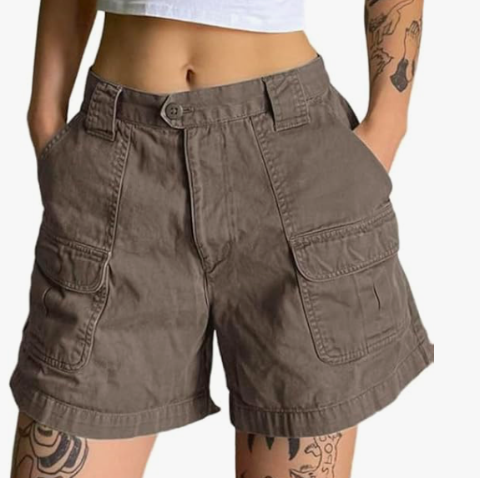
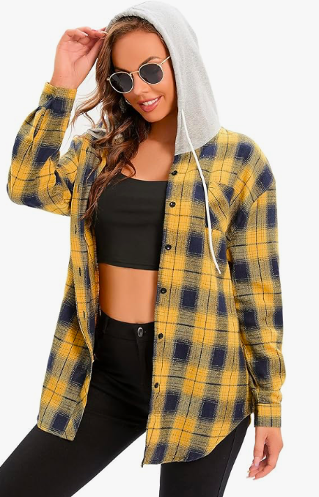
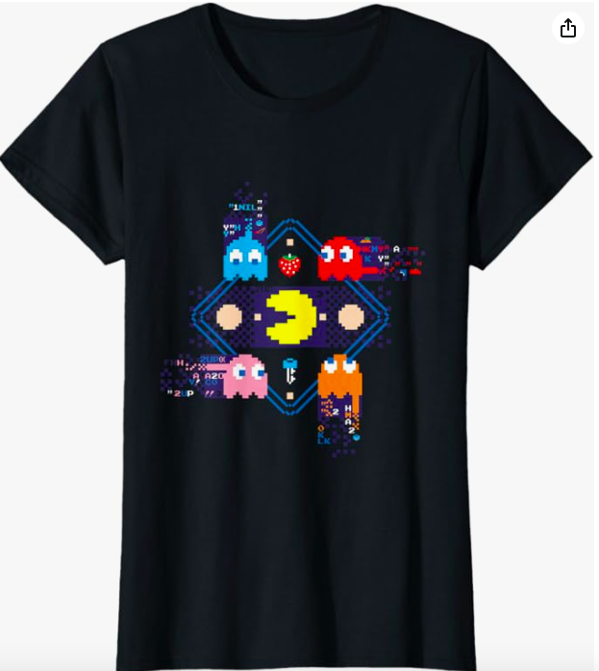
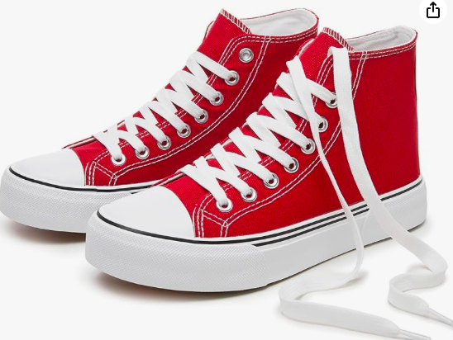
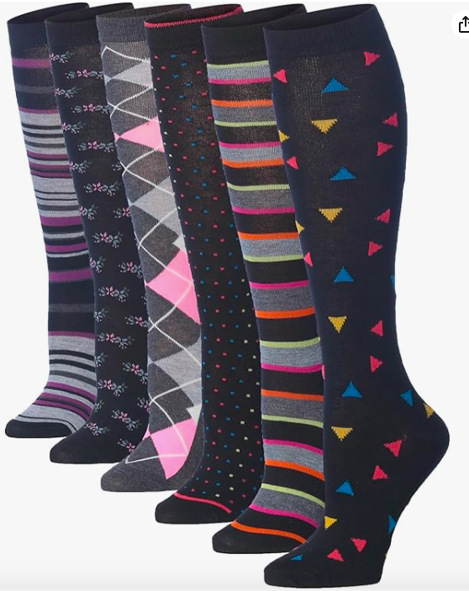

Slide 6
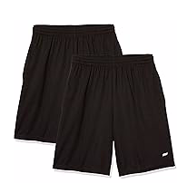
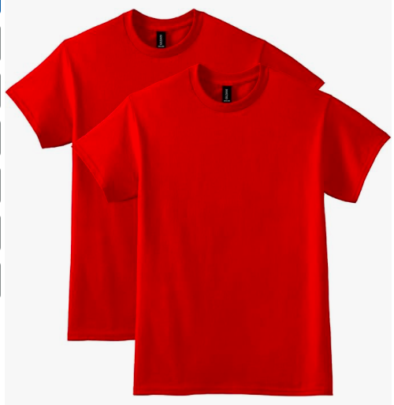
Gym Attire

Slide 7

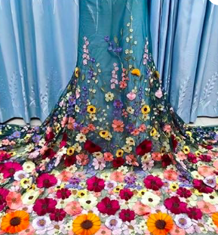
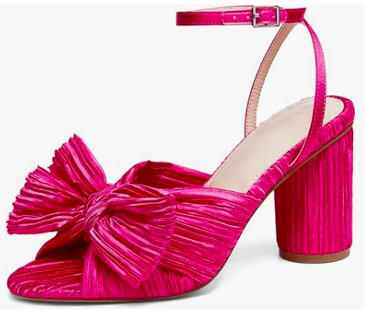

Slide 8
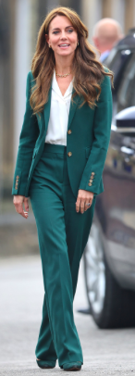
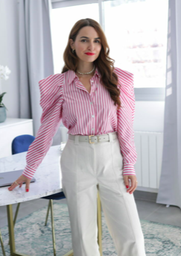
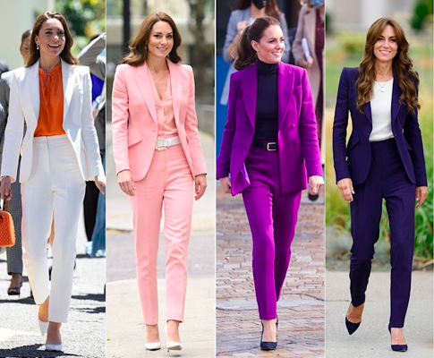
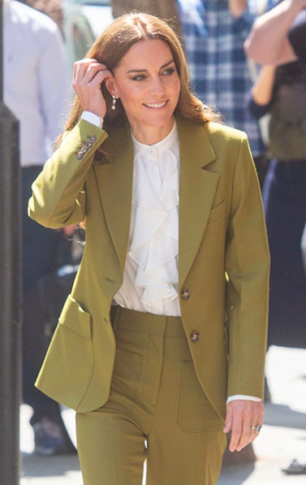
Katherine Blake
Very put together, businesswoman,
strong and confident
Inspo: Kate Middleton, AOC, Leslie Knope

Slide 9
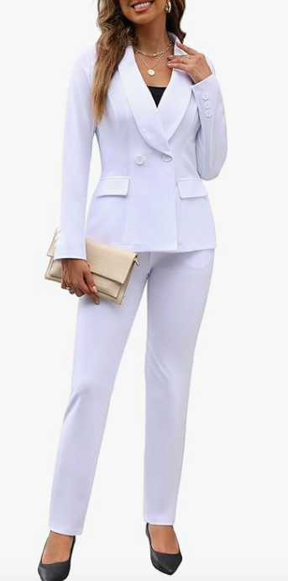

Slide 10
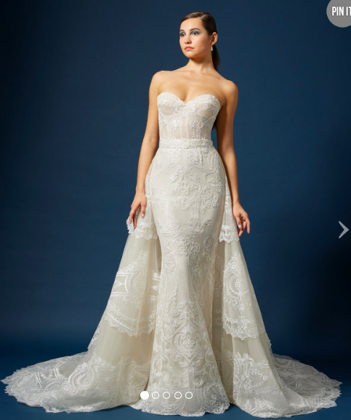
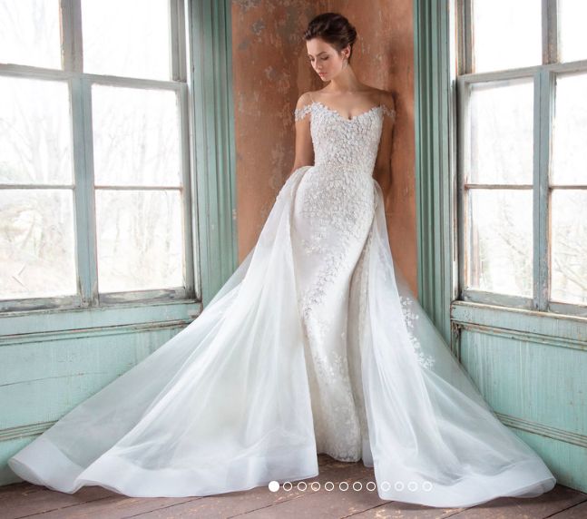
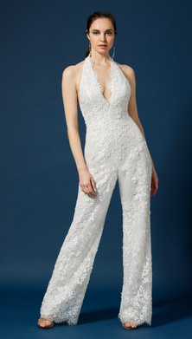
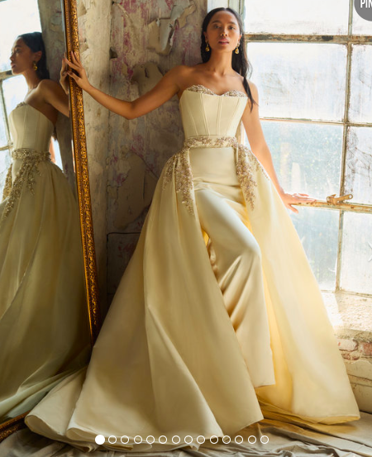

Slide 11

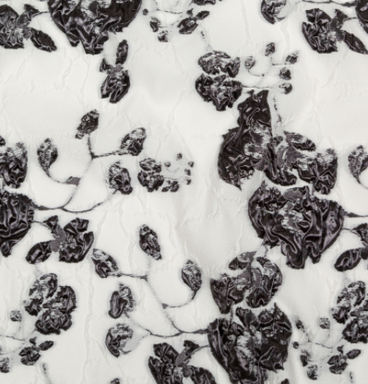

Slide 12
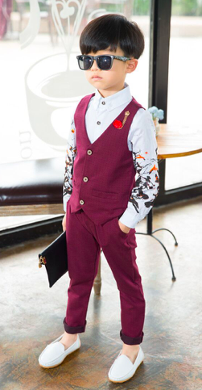
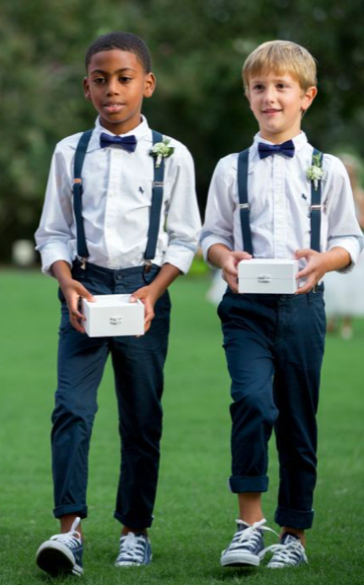
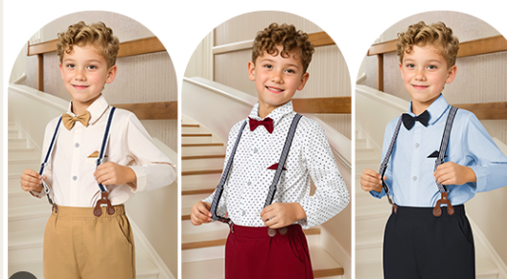
Fletcher Blake
Brown Courderoy pants, gray muppets tshirt, brown and
black Velcro corrective shoes

Slide 13



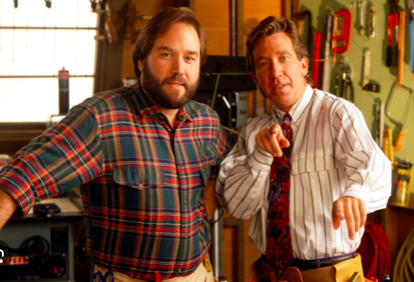
Mike
Inspo: Tim Taylor

Slide 14
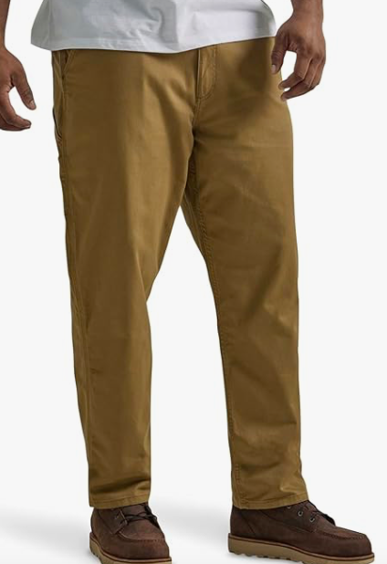
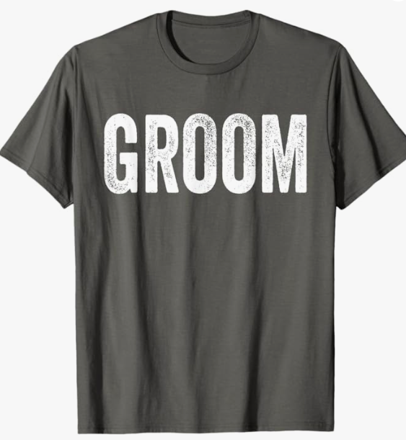
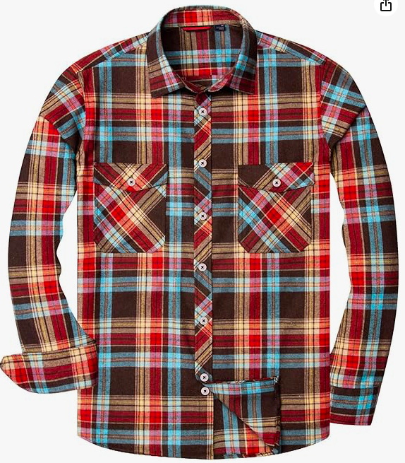

Slide 15
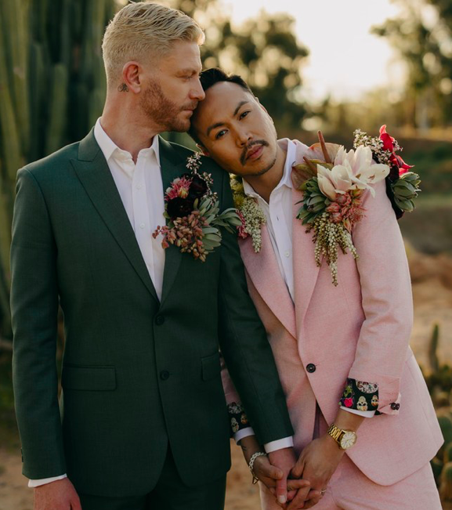
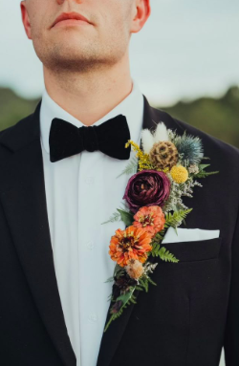
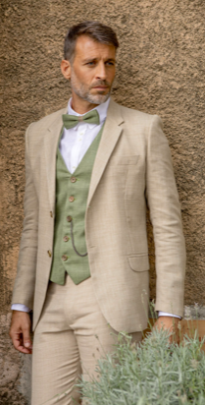
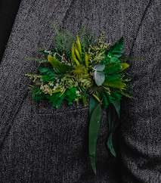

Slide 16
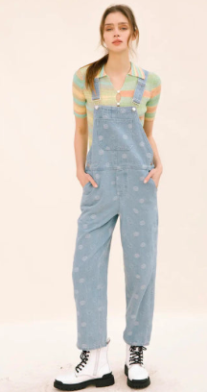
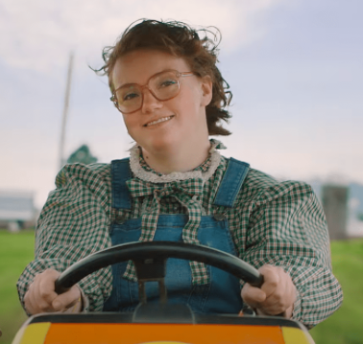
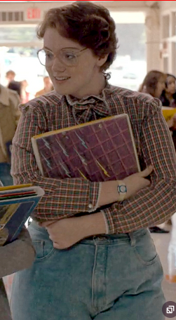
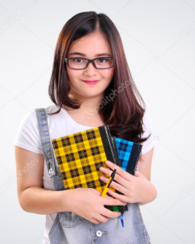
Hannah
Ends up at computer camp, more nerdy, like
Barb in Stranger things if she lived. Sweater vest
under overalls?

Slide 17
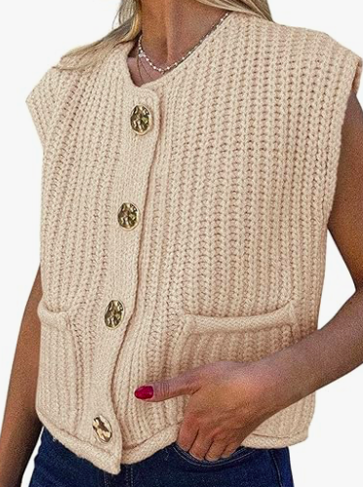
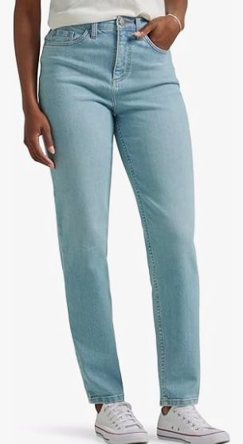
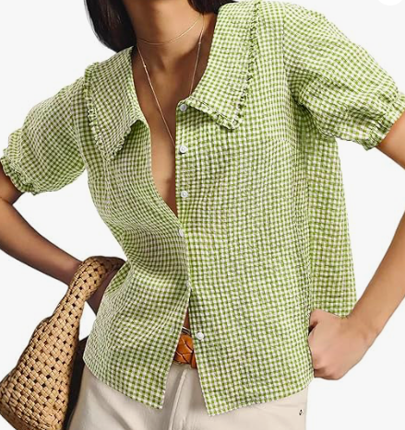

Slide 18
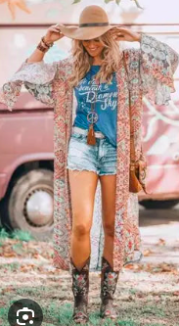

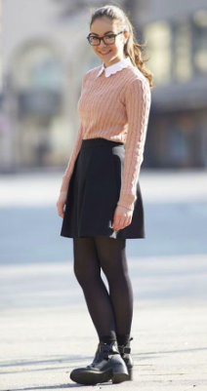
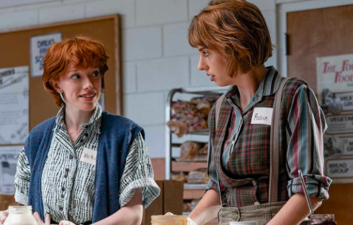
Gretchen
Goes to Sweden and starts a punk/ country
band. A bit boho, a bit country, a bit rock…

Slide 19





Slide 20




Adam
List master, too cool for school.

Slide 21




Savannah
Queen of the school, gets whatever
She wants. Inspo: All those leading female jerks

Slide 22





Slide 23






Slide 24



Slide 25
Laurel/ Wells
Henchman of Savannah, similar aesthetic

Slide 26



Wells

Slide 27




Laurel

Slide 28



Parker
Not a Jock per say, but represents
His favourite team. Needs to change to Louis
Easily

Slide 29




Louis
Needs to change to
Parker easily

Slide 30





Slide 31




Caterers
White shirt, black ties, vests, and pants

Slide 32




Torrey
Very functional, very practical,
Simple blouse and skirt

Slide 33





Slide 34





Grandpa Gordon
Inspo: Carl from Up!, F. Murray Abraham
from White Lotus S2

Slide 35




Grandma Helene
Inspo: Grandma Joy and Iris Apfel

Slide 36






Slide 37





Slide 38




Ms. Meyers
Inspo: Sue Sylvester and Miss Trunchbull

Slide 39




Mr. Blumen

Slide 40




Mrs. Luckenbill
Inspo: Miss Honey (Matilda)
and Janine (Abbot Elementary)

Slide 41




Mrs. Time
Cocoon type robe, head wrap

Slide 42



Slide 43




Danielle
Inspo: Julie Chen, Georgia
Hardstark, Karen Kilgariff.
Bright colors, bold patterns

Slide 44



Dr. Ehrin

Slide 45




Pastor Bruno
Black pastor shirt with collar, gray suit

Slide 46




Chicago Police officers

Slide 47



Srta. O’Brien
Inspo: Theatre teacher from HSM, every one of my teachers from SIT

