Slide 1
Heebie Jeebies
Design ideas

Slide 2
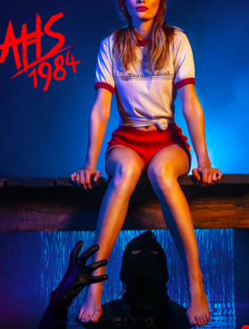
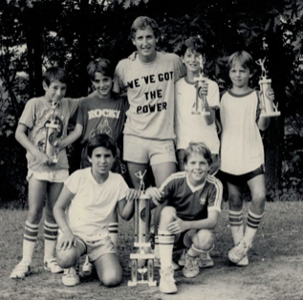
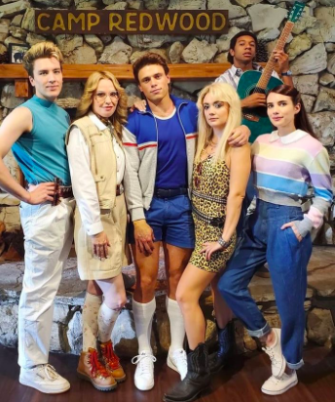
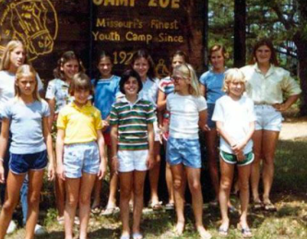

Slide 3
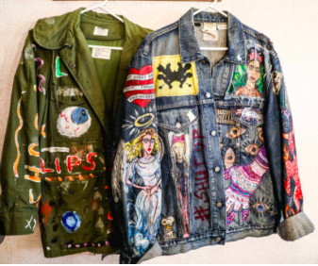
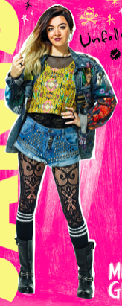
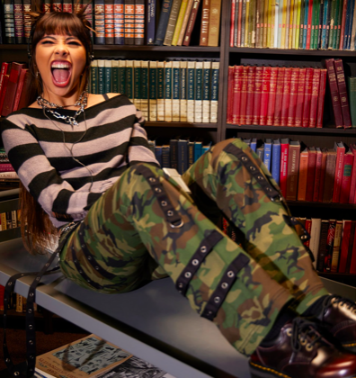
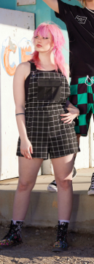
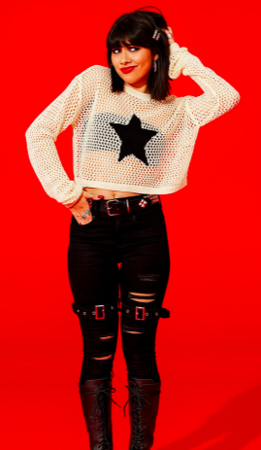
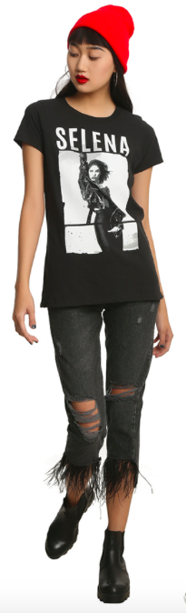
Actor 1 (f) : Charlie, Taylor
Charlie: Modern. Not a “bad” kid, but wants to be older than she is. Challenges Authority.
Doc Martins, probably shops at Hot
Topic. Not goth, but mom would
definitely roll her eyes when she
comes downstairs.

Slide 4
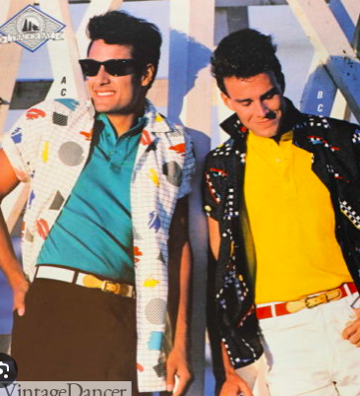
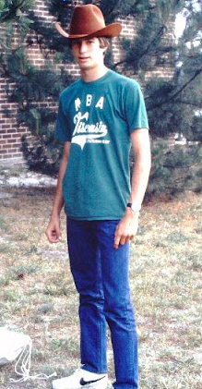
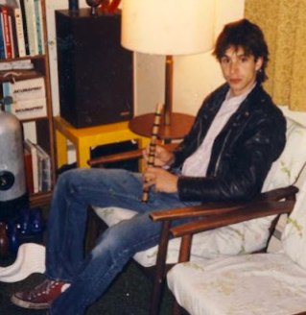
Actor 2 (m): Mickey, Danny, Chris, Courier, Student 2
Mickey: Attacked by a bear.
Goofy and Sarcastic
Jeans with a cuff, converse, camp shirt under a windbreaker. Back of camp shirt can be cut up from bear attack. OR 1980’s ripped jeans/
Shirt style

Slide 5
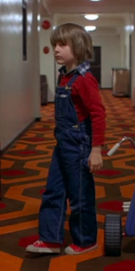
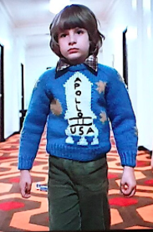
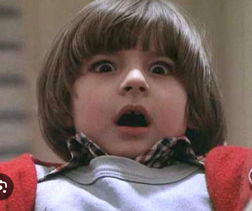
Actor 2: Danny
Add on red sweater with a faux collar and bib of overalls built onto it

Slide 6
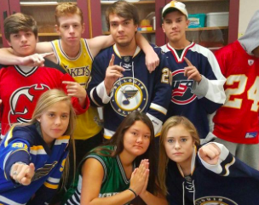
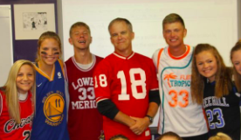
Actor 2: Chris
ADD Jersey and cap

Slide 7
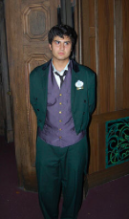
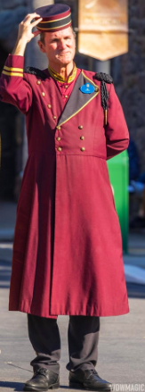
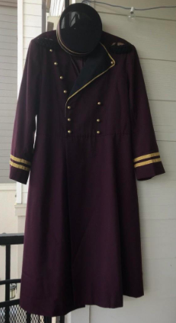
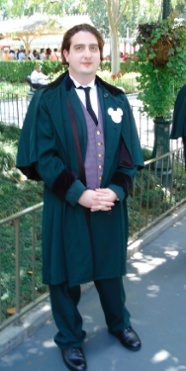
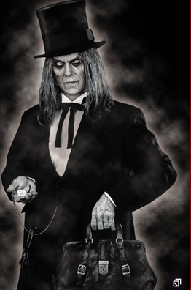
Actor 2: Courier

Slide 8
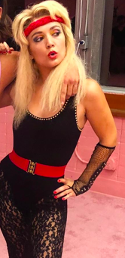
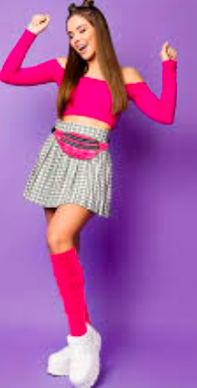
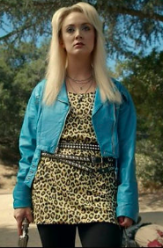
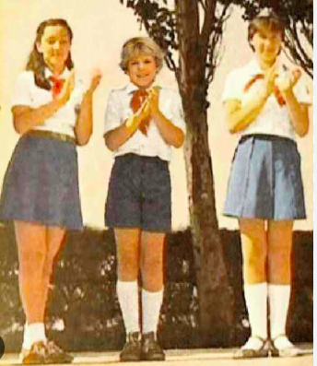
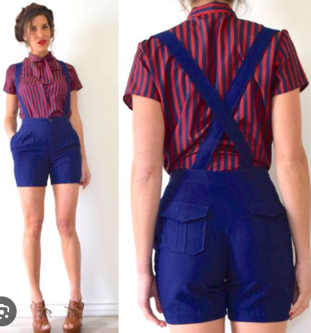
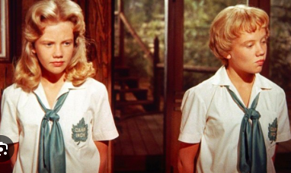
Actor 3 (f): Hollis, Kelsey, Professor Newt, Max, Student 1
Hollis: dies by hornet stings. Leader. Was the “first soul” at camp.
Red mesh shirt under camp tshirt (Like hornets stings), navy
button shorts, bandana, white keds.

Slide 9
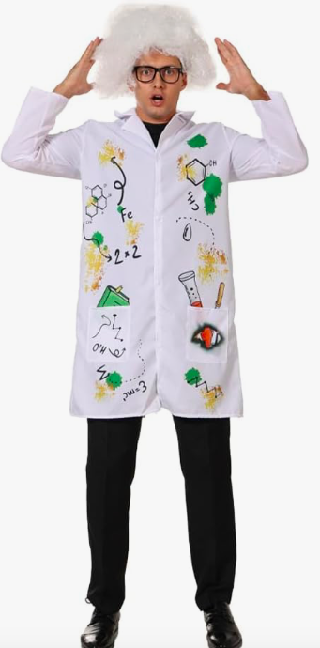
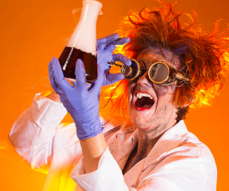
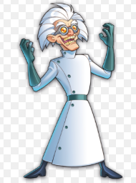
Actor 3: Kelsey- ADD bathrobe
Actor 3: Professor Newt: Start sweet and nerdy and transition to evil scientist vibes (a symmetrical coat, green gloves and belt, just real evil scientist vibes). Also add frog gloves

Slide 10
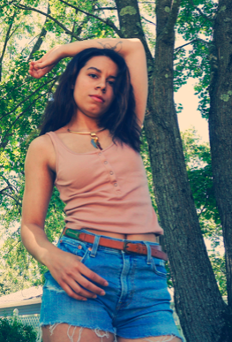
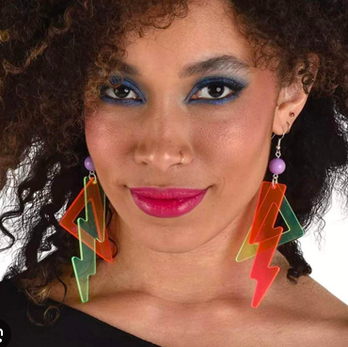
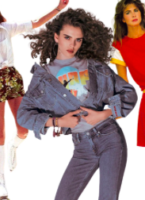
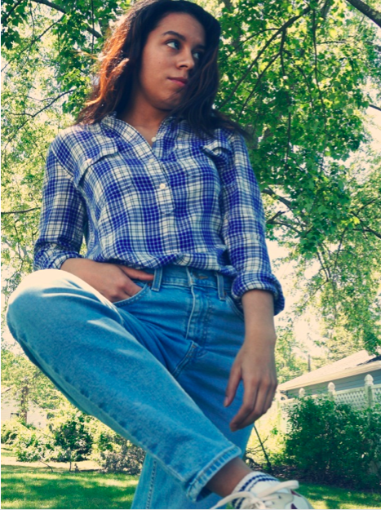
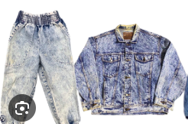
Actor 4 (f): Tony, Kendal, Mrs. Torrance, Morgan, Blake, Student
Tony: Killed by lightning. Tough and Fiesty.
Camp tank top, jean shorts/skirt, flannel, keds

Slide 11
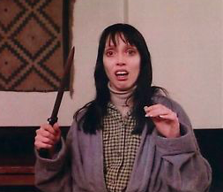
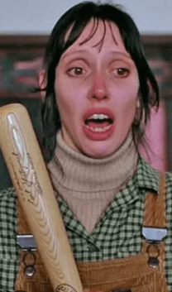
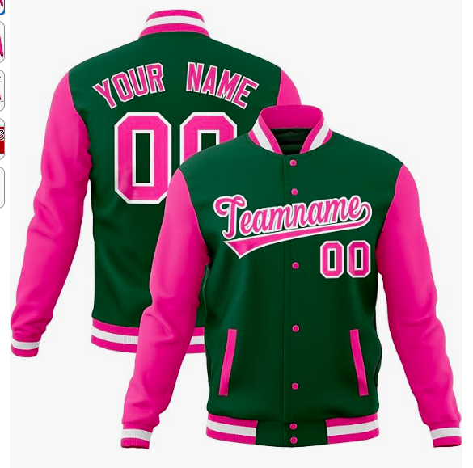
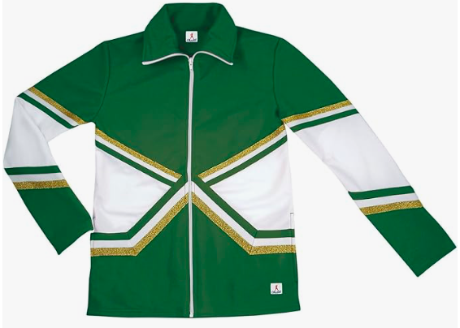
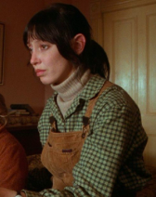
Actor 4: Kendal- ADD sleep mask on forehead and slippers
Actor 4: Mrs. Torrance
Actor 4: Morgan- Popular girl, breaks up with Chris
ADD Members only/ varsity
Jacket- can customize
ADD turtleneck dickie, green flannel, and brown corderoy overskirt

Slide 12
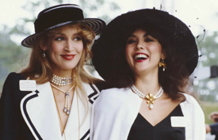
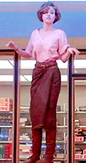
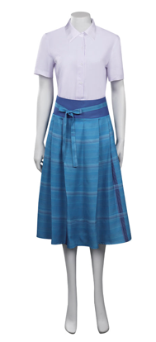
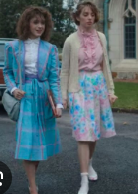
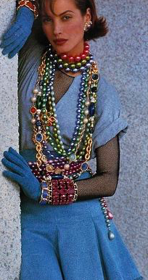
Actor 5 (f): Jesse, Sydney, Jordan, Frances, Nurse Gill, Logan, Beauty Genie, Counselor 2
Jesse: Dies by choking on marshmallows. Kind and Genuine.
Camp tshirt, skirt with big belt, choker necklace, keds

Slide 13
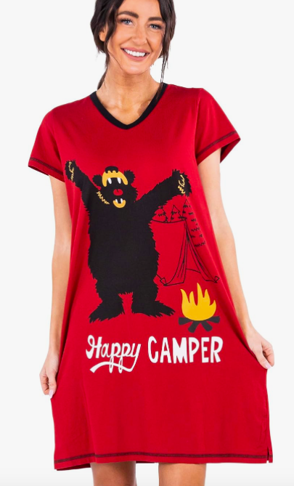
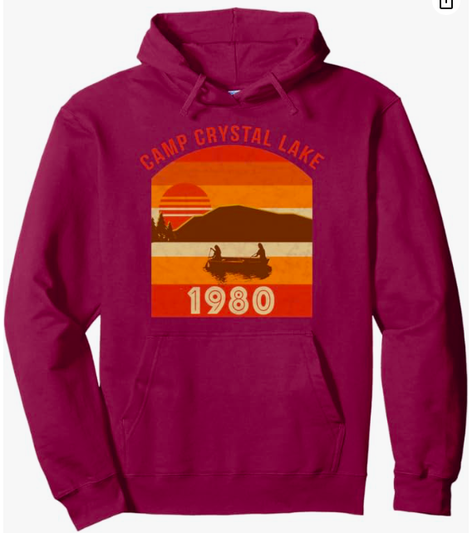

Actor 5: Sydney- ADD night gown
Actor 5: Jordan – Babysitter. ADD Hoodie
Actor 5: Nurse Gill- ADD Nurse headband (But in green)

Slide 14
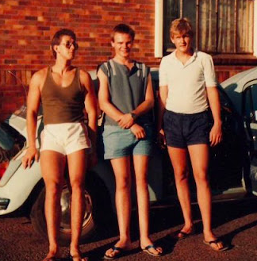



Actor 6: Pat, Casey, Robin, Dad, Counselor 1, Student
Pat: Dies of hypothermia. Brainy and verbose
Shortest shorts I can get away with, camp shirt with sleeves rolled/
cut into muscle shirt. 80’s socks and converse.

Slide 15






Actor 6: Casey- Add blond wig in head wrap?
Actor 6: Robin- Add lab coat/ tshirt
Actor 6: Dad- Ned Flanders like. ADD green Sweater with pink faux collar, Moustache glasses
Actor 6: Counselor- Add camp windbreaker

Slide 16



Students
Three choices for the final story:
1.) Neck gaiters that can be worn as headbands/ around neck with
hoodies
2.) Full morph face masks like we used in ITT
3.) Featureless mask, sort of like we used in ITT

